Slide 2
Objectives
Identify the new functions of CSS3
Explain the different types of selectors
^{Explain nested tags}
Define Classes and IDs for applying styles
Explain the process to apply styles to hyperlink

Slide 3
Introduction
Cascading Style Sheet (CSS) is a style sheet language.
It informs the browser how to present a document.
It uses a markup language for describing the presentation semantics of a document.
It defines how HTML elements are to be displayed.

Slide 4
Cascading Style Sheet 3 (CSS3)
Used for adding style such as fonts, colors, and spacing to Web documents.
Has multiple levels and profiles.
Updates each level of CSS from the earlier version, by adding new features.
Denotes version as CSS1, CSS2, CSS3, and CSS4, where the numbers are different for each version or level.
Is divided into multiple documents called “modules” and each of these modules have new capabilities or extends the features present in CSS2.
Started drafting of CSS3 when publication of the original CSS2 recommendation was released.

Slide 5
Modules 1-4
As CSS3 is available as modules and is still evolving, there are many modules having different stability and status.
Only three modules are released as recommendations and they are as follows:
CSS Color Level 3
CSS Namespaces
Selectors Level 3
Modules that are stable and in recommendation stage are as follows:
Media Queries
CSS Style Attributes

Slide 6
Modules 2-4
Modules that are in testing phase and in recommendation stage are as follows:
CSS Backgrounds and Borders Level 3
CSS Image Values and Replaced Content Level 3
CSS Marquee
CSS Multi-column Layout
CSS Speech
CSS Mobile Profile 2.0
CSS TV Profile 1.0
Modules that are in refining phase and in working draft stage are as follows:
CSS Transforms
CSS Transitions
CSS Values and Units Level 3
CSS Print Profile

Slide 7
Modules 3-4
Modules that are in revising phase and in working draft and recommendation stage are as follows:
CSS Animations
CSS Flexible Box Layout
CSS Fonts Level 3
CSS Paged Media Level 3
CSS Text Level 3
CSS Basic User Interface Level 3
CSS Writing Modes Level 3
Some of the following modules are in exploring phase and in working draft stage:
CSS Cascading and Inheritance Level 3
CSS Conditional Rules Level 3
CSS Grid Layout
CSS Line Grid

Slide 8
Modules 4-4
Modules that are in rewriting phase and in working draft stage are as follows:
CSS Line Layout Level 3
CSS Ruby
CSS Syntax Level 3
Modules that are in abandoned phase and in working draft stage are as follows:
Behavioral Extensions to CSS
CSS Hyperlink Presentation

Slide 9
CSS Syntax 1-2
Syntax of CSS consists of three parts namely, selector, property, and value.
Selector is an HTML element for which you want to specify the style or the formatting instruction.
Property of a selected element is a CSS property that specifies the type of the style to be applied to the selector.
Value refers to the value of the CSS property and a CSS property can have multiple values.
Property and the value for a selector are separated with a colon (:).
They are enclosed within the curly brackets ({}) that is known as the declaration block.

Slide 10
CSS Syntax 2-2
Various combinations available to specify rules for HTML elements are as follows:
You can specify multiple property-value pairs for a selector, which are separated by a semicolon (;) within the declaration block.
You can specify multiple selectors for a single property by grouping the selectors. To group the selectors, the selectors are separated by commas followed by a declaration block of properties and values.
You can specify properties for multiple selectors. Here, the comma-separated selectors are followed with multiple property-value pairs.

Slide 11
Length Measurement Units 1-3
CSS uses various units of measurements for specifying size of the font, width, and height of margins, and so on.
These units measure the horizontal and vertical length of the content.
CSS supports two types of length measurement units namely, relative and absolute.

Slide 12
Length Measurement Units 2-3
Relative length specifies the length units related to other length property that are calculated in comparison to a current value.
Following table lists some of the relative length units.
^{Relative Length} | ^{Description}
^{em} | Specifies the font size (height) of a particular font. The em unit is relative to the value of the font-size property of the selector.
^{ex} | Specifies the ‘x-height’ of a particular font. The ‘x-height’ value is approximately half the font size or the height of the lowercase letter ‘x’.
^{px} | Specifies the size in pixels, which is relative to the screen of the device.

Slide 13
Length Measurement Units 3-3
Absolute lengths are specified when the Web page designer is aware of the physical properties of the output device and are specific and fixed values.
Following table lists some of the absolute length units.
^{Relative Length} | ^{Description}
^{in} | Specifies the size in inches, where 1 inch = 2.54 centimeters.
^{cm} | Specifies the size in centimeters’
^{mm} | Specifies the size in millimeters
^{pt} | Specifies the size in points, where 1 point = 1/72th of an inch
^{pc} | Specifies the size in picas, where 1 pica = 12 points

Slide 14
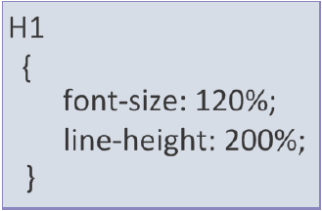
Length Measurement Units 3-3
Percentage allows specifying the length of the content, which is relative to another value.
Shows the use of percentage in defining the style.

Slide 15
Types of Style Sheets
Three types of style sheets namely, inline, internal or embedded, and external style sheets.
An inline style sheet uses the style attribute within an HTML element to specify the style for HTML elements.
An internal style sheet is also included within the HTML document and is defined using the style element.

Slide 16
Internal/Embedded Styles 1-2
Type attribute of the style element specifies the content type, which is text/css
Internal Styles
Placed inside the <head> section of a particular Web page source code
Style rules appear in a declaration block for each HTML element under the style element
Styles can be re-used in the same Web page in which they are placed

Slide 17
Internal/Embedded Styles 2-2
The Code Snippet demonstrates how to specify internal style.
^{<head>}
^{<meta charset=“utf-8”>}
<title>Sample HTML5 Structure</title>
^{<style>}
^{h1, h2 {}
^{margin:0px;}
^{font-size:1.5em;}
}
^{footer{}
^{background-color:#999;}
^{text-align:center;}
}
^{</style>}
^{</head>}

Slide 18
Inline Styles
Inline Styles
Are placed directly inside an HTML element
Cannot be reused at any point of time in a Web page
Web designer cannot use the style builder to create an inline style
The Code Snippet demonstrates the use of inline style.
<p style=”font-size: 14px; color: purple;”></p>

Slide 19
External Style Sheet 1-2
External Style Sheet
External CSS is defined in a separate file and is saved with the .css extension
External CSS are widely used to provide a consistent look across the Web pages of a Web site
Provides the benefit of reusability by implementing common style rules for multiple HTML pages
The Code Snippet demonstrates the use of external CSS.
^{BODY {}
^{background-color: gray;}
^{font-family: arial;}
^{font-style: italic;}
}

Slide 20
External Style Sheet 2-2
Code Snippet shows an example of HTML code using an external CSS style sheet demonstrated earlier.
^{<!DOCTYPE html>}
^{<html>}
^{<head>}
<LINK rel=“stylesheet” type=“text/css” href=“body.css”/>
^{<title>Webex e-Server</title>}
^{</head>}
^{<body>}
This is the fastest web server..!!
^{</body>}
^{</html>}

Slide 21
Selectors 2-5
Selectors refer to the HTML elements with the styles that the users want to apply to them.
The four different types of CSS selectors are as follows:
Universal selector
Selectors
Type selector
ID selector
Class selector

Slide 22
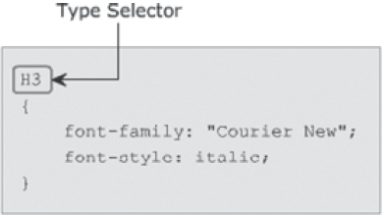
Type Selector
Styles are specified only once for an HTML element and are applied to all the occurrences of that elements
Specifies the element name along with the styles to be applied to that element
Results in application of the specified styles to all the occurrence of that element in a Web page

Slide 23
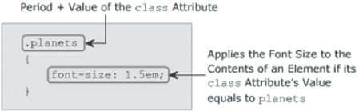
Class Selector
Class selector starts with a period followed by the value of the class attribute
Matches elements, whose class attribute is set in an HTML page
Applies styles to the content of all those elements having the same class attribute

Slide 24
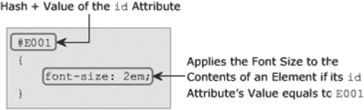
ID Selector
ID selector starts with the hash symbol (#) followed by the id attribute’s value and the declaration block
Matches an element whose id attribute is set in an HTML page
Applies styles to the content of all those elements

Slide 25

Universal Selector
Represented by an asterisk (*) sign
Can be applied to all elements in the document
Applies the specified styles to the content of all the elements

Slide 26
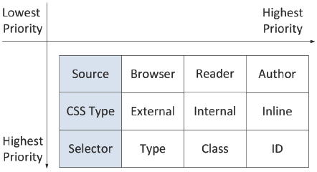
Generic Cascading Order
W3C has defined some rules for applying styles to an HTML element. These rules are:
Gather all the styles that are to be applied to an element.
Sort the declarations by the source and type of style sheet. The source specifies the origin from where the styles are rendered.
Highest priority is given to the external style sheet defined by an author. The next priority is of the reader, which can be a software that reads the content, and the last priority is of the browser.
Sort the declarations by the priority of a selector, where the ID selector has the highest priority.
Sort the declaration according to the specified order.

Slide 27
Comments
Are marked with special characters, ‘/*’ and ‘*/’ and can be single-line and multi-line comments
Comments
Refers to the descriptive text in a Web page
Make the program readable and help the designer to explain the styles specified for elements
Allows a Web page designer to provide information about the CSS code

Slide 28
Psuedo Classes 1-3
Following table lists the different states of an element:
Sometimes unknowingly the same Web page get open that you have already visited.
You might feel the need for a mechanism that could differentiate the already visited links from the remaining ones.
This is possible by using pseudo classes.
Pseudo classes allow the users to apply different styles to the elements such as buttons, hyperlinks, and so on.
^{State} | ^{Description}
^{active} | Defines a different style to an element that is activated by the user.
^{hover} | Defines a different style to an element when the mouse pointer is moved over it.
^{link} | Defines a different style to an unvisited hyperlink.
^{visited} | Defines a different style to the visited hyperlink.
Syntax for declaring Pseudo classes are as follows:
selector_name:state_name {property: value}

Slide 29
Psuedo Classes 2-3
Following table lists the selector name and its descriptions:
^{Selector Name} | ^{Description}
^{:link} | Is used for selecting all unvisited links
^{:active} | Is used for selecting the active link
^{:hover} | Is used for selecting links on mouse over
^{:visited} | Is used for selecting all visited links
^{:focus} | Is used for selecting the input element which has focus
^{:first-letter} | Is used for selecting the first letter of every <p> element
^{:first-line} | Is used for selecting the first line of every <p> element
^{:first-child} | Is used for selecting every <p> elements that is the first child of its parent
^{:before} | Is used for inserting content before every <p> element
^{:after} | Is used for inserting content after every <p> element

Slide 30
Psuedo Classes 3-3
Pseudo classes specify the styles to be applied on an element depending on its state.
In CSS3, a selector can contain multiple pseudo-classes.
These pseudo-classes should not be mutually exclusive.
Code snippets demonstrates the use of CSS code specifying the different styles for the visited links, unvisited links, and for the links when the mouse hovers over it.
^{a:link {}
^{color: white;}
^{background-color: black;}
^{border: 2px solid white;}
}
^{a:visited {}
^{color: white;}
^{background-color: brown;}
^{border: 2px solid white;}
}
^{a:hover {}
^{color: black;}
^{background-color: white;}
^{border: 2px solid black;}
}
Specifies the styles for an unvisited link
Specifies the styles for a visited link
Specifies the styles when a mouse hovers over it

Slide 31
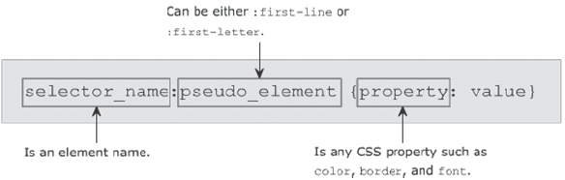
Purpose of Psuedo Elements
Consider a scenario where you are designing a Web site that explains the important technical terms.
While defining such terms, you might feel the need to emphasize more on the first letter by applying different styles.
Pseudo elements provide you with a flexibility to apply styles to a specific part of the content such as a first letter or first line.
Pseudo element adds some special effects to HTML elements such as <p>, <body>, and so on.
Syntax for declaring psuedo elements is:

Slide 32
Psuedo Elements 1-2
The :first-line and :first-letter pseudo elements allow you to apply styles to the first line and first letter respectively.
The :first-line pseudo element allows you to apply styles to the first line.
The Code Snippet declares the style that will be applied to the first line in the paragraph.
^{p:first-line}
{
^{font-family: “Tahoma”;}
^{font-weight: bolder;}
^{background-color: #FFFFCC;}
}
Specifies the styles to be applied to the first line of the paragraph content

Slide 33
Psuedo Elements 2-2
The :first-letter pseudo element allows you to apply styles to the first letter.
The Code Snippet declares the style that will be applied to the first letter in the paragraph.
^{p:first-letter}
{
^{font-family: “fantasy”;}
^{font-size: xx-large;}
^{font-weight: bold;}
}
Specifies the styles to be applied to the first letter of the paragraph content

Slide 34
Styles to Hyperlink
CSS can be used to change the appearance and behavior of hyperlinks.
There are two other ways to assign hyperlink styles namely, div specific and Link specific.
A div specific hyperlink styles can be created and assigned to a specific div and will have all the hyperlinks present within the div to follow the specified rules.
Class specific hyperlink styles generally uses a class than an id. A point to note that an id can only be used once on a page whereas a class can be used multiple times as required.

Slide 35
Summary
CSS is a mechanism for adding style such as fonts, colors, and spacing to Web documents. CSS has multiple levels and profiles.
The general syntax of CSS consists of three parts namely, selector, property, and value.
Selectors refer to the HTML elements with the styles that are applied to them and they can be Type, Class, ID, or Universal selectors.
A comment refers to the descriptive text that allows a Web page designer to provide information about the CSS code.
Pseudo classes allow the users to apply different styles to the elements such as buttons, hyperlinks, and so on.
Pseudo elements allow the developer to apply styles to a specific part of a content such as first letter or first line.
A hyperlink style can be assigned either through DIV or through link class.

